Slide 1

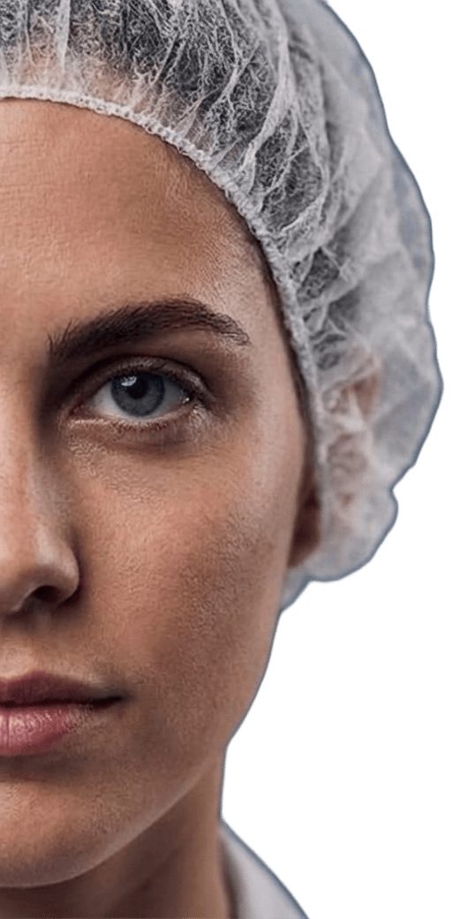
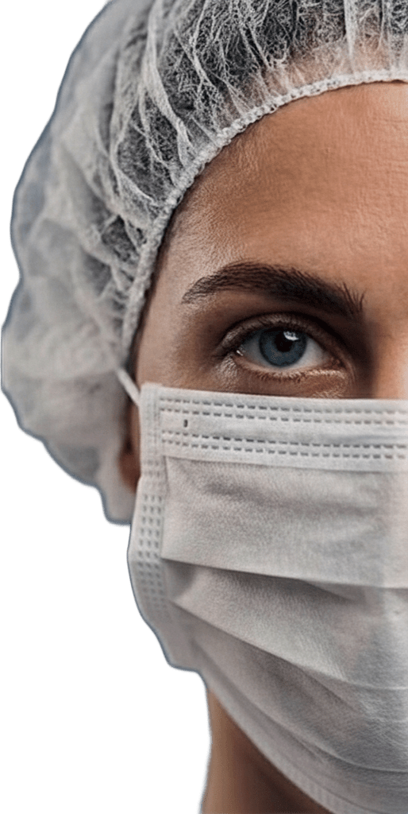
Face Mask Detection Using CNN
Mask vs No Mask Classification
CS417 – Project 7

Slide 2
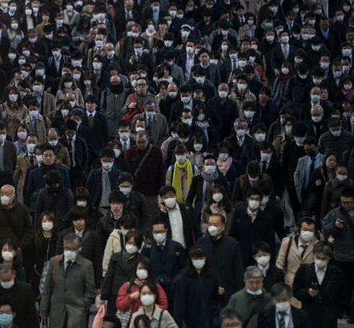

Project Overview
Problem
Importance of the project
Proposed Solution

Slide 3
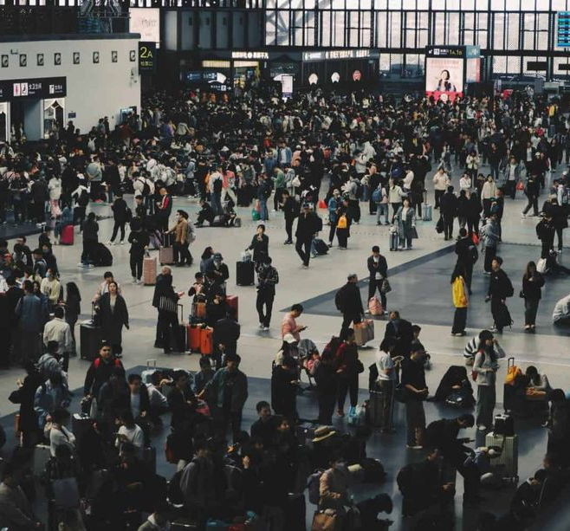
Project Overview
What is this project?
A computer vision project
Uses CNN to classify images into:
Mask
No Mask
Built and trained using TensorFlow / Keras
Problem
Importance of the project
Proposed Solution

Slide 4
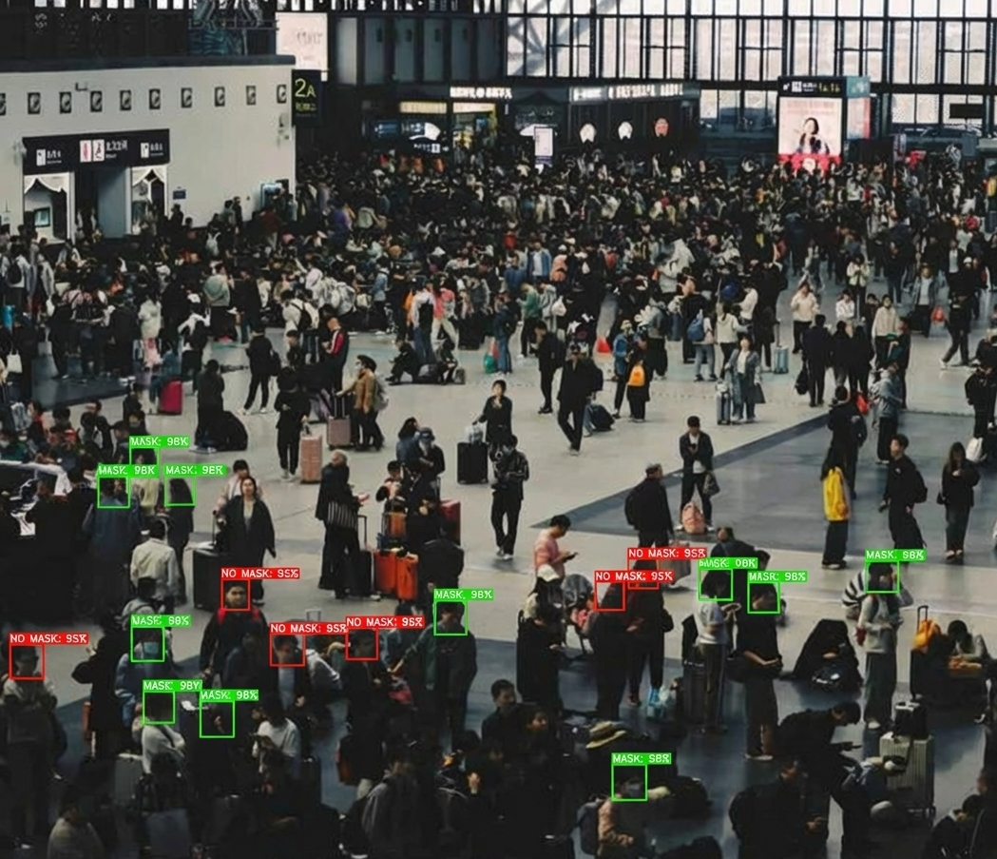
Project Overview
Problem
The Problem
Manual monitoring of mask usage is difficult
Crowded places need automatic detection
Human supervision is slow and inefficient
Importance of the project
Proposed Solution

Slide 5
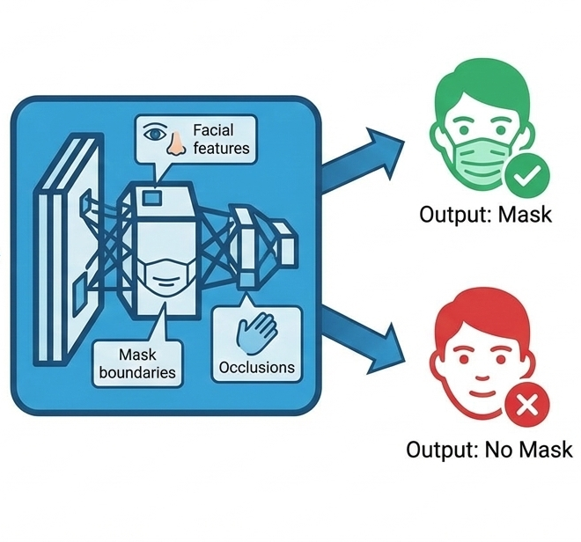
Project Overview
Problem
Importance of the project
Why is this important?
Helps enforce public health rules
Reduces need for human monitoring
Can work in real-time
Useful in high-traffic environments
Proposed Solution

Slide 6
Project Overview
Problem
Importance of the project
Proposed Solution
Our Solution
Train a CNN model
Input: face image
Output: Mask / No Mask
Model learns:
Facial features
Mask boundaries
Occlusions

Slide 7
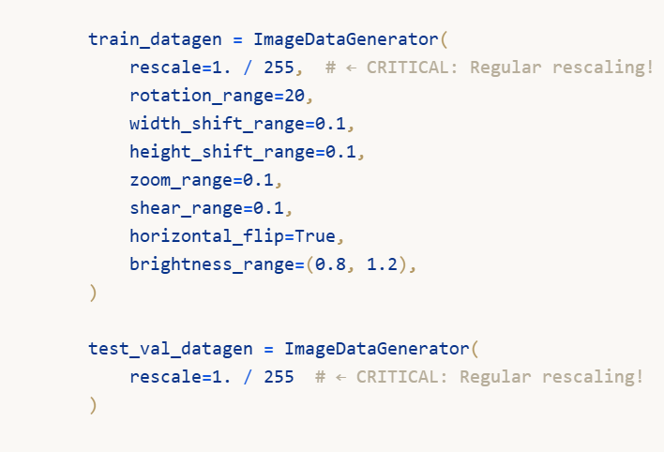
Dataset
Kaggle Face Mask Detection Dataset
Two classes:
Mask
No Mask
Preprocessing
Resize images to 128x128

Slide 8
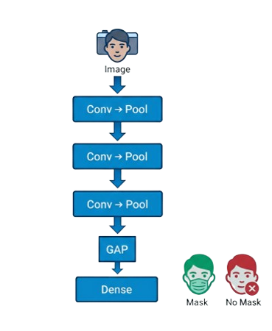
Model Architecture & Implementation
Architecture:
Convolution layers extract facial
and mask features
MaxPooling reduces spatial dimensions
Global Average Pooling reduces
parameters
Dropout prevents overfitting
Sigmoid output for binary classification

Slide 9
Model Training Setup
Training Configuration:
Optimizer: Adam
Loss Function: Binary Cross-Entropy
Epochs: 20
Batch Size: From data generator
Learning Rate:
CNN: 1e-4
EfficientNet (fine-tuning) : 1e-5
Training Strategy:
EarlyStopping to prevent overfitting
ModelCheckpoint to save best model
ReduceLROnPlateau too adjust learning rate
Validation accuracy monitored

Slide 10
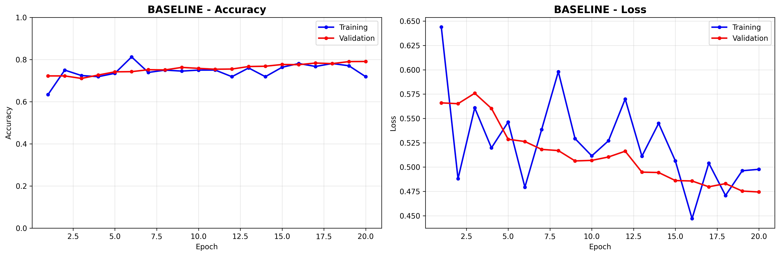

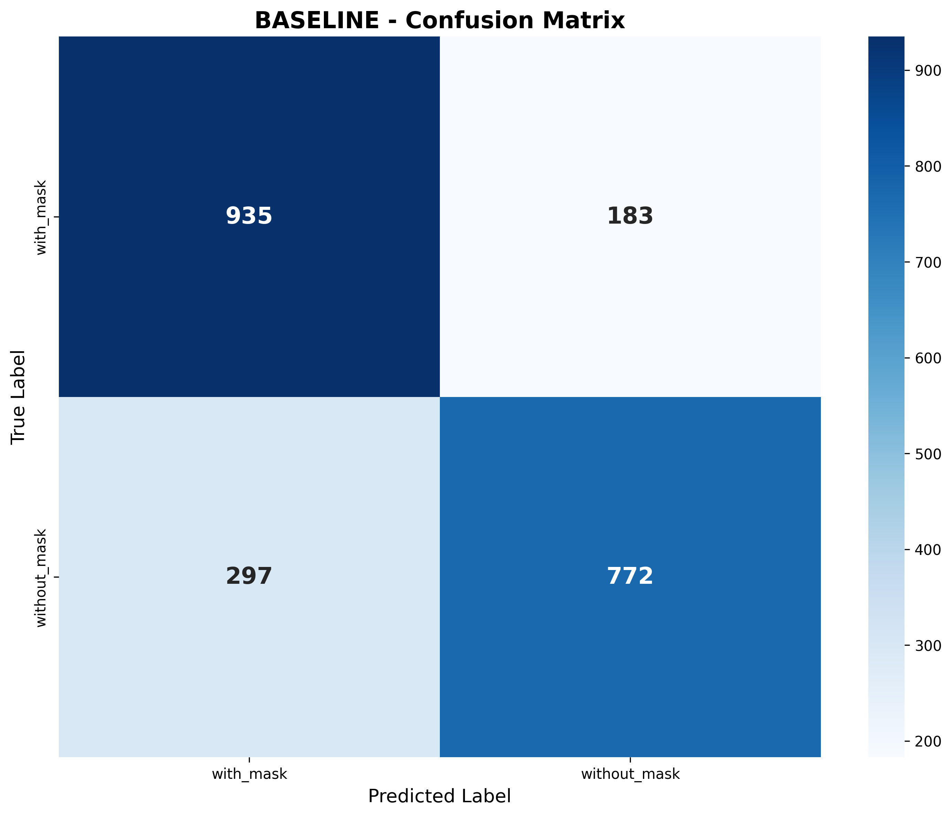
Results
Baseline Model
Class / Metric | Precision | Recall | F1-Score | Support
With Mask | 0.7589 | 0.8363 | 0.7957 | 1118
Without Mask | 0.8084 | 0.7222 | 0.7628 | 1069
Accuracy | — | — | 0.7805 | 2187
Macro Average | 0.7837 | 0.7792 | 0.7793 | 2187
Weighted Average | 0.7831 | 0.7805 | 0.7797 | 2187

Slide 11
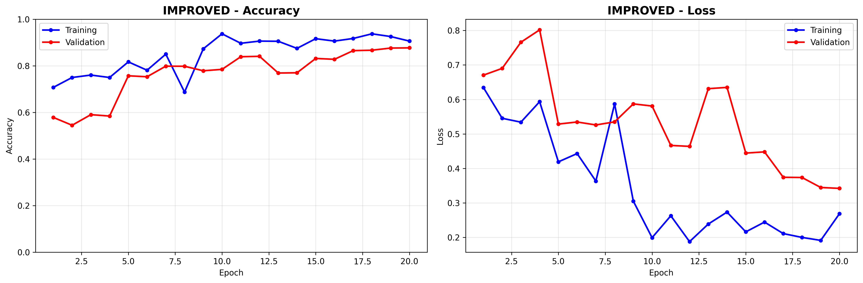
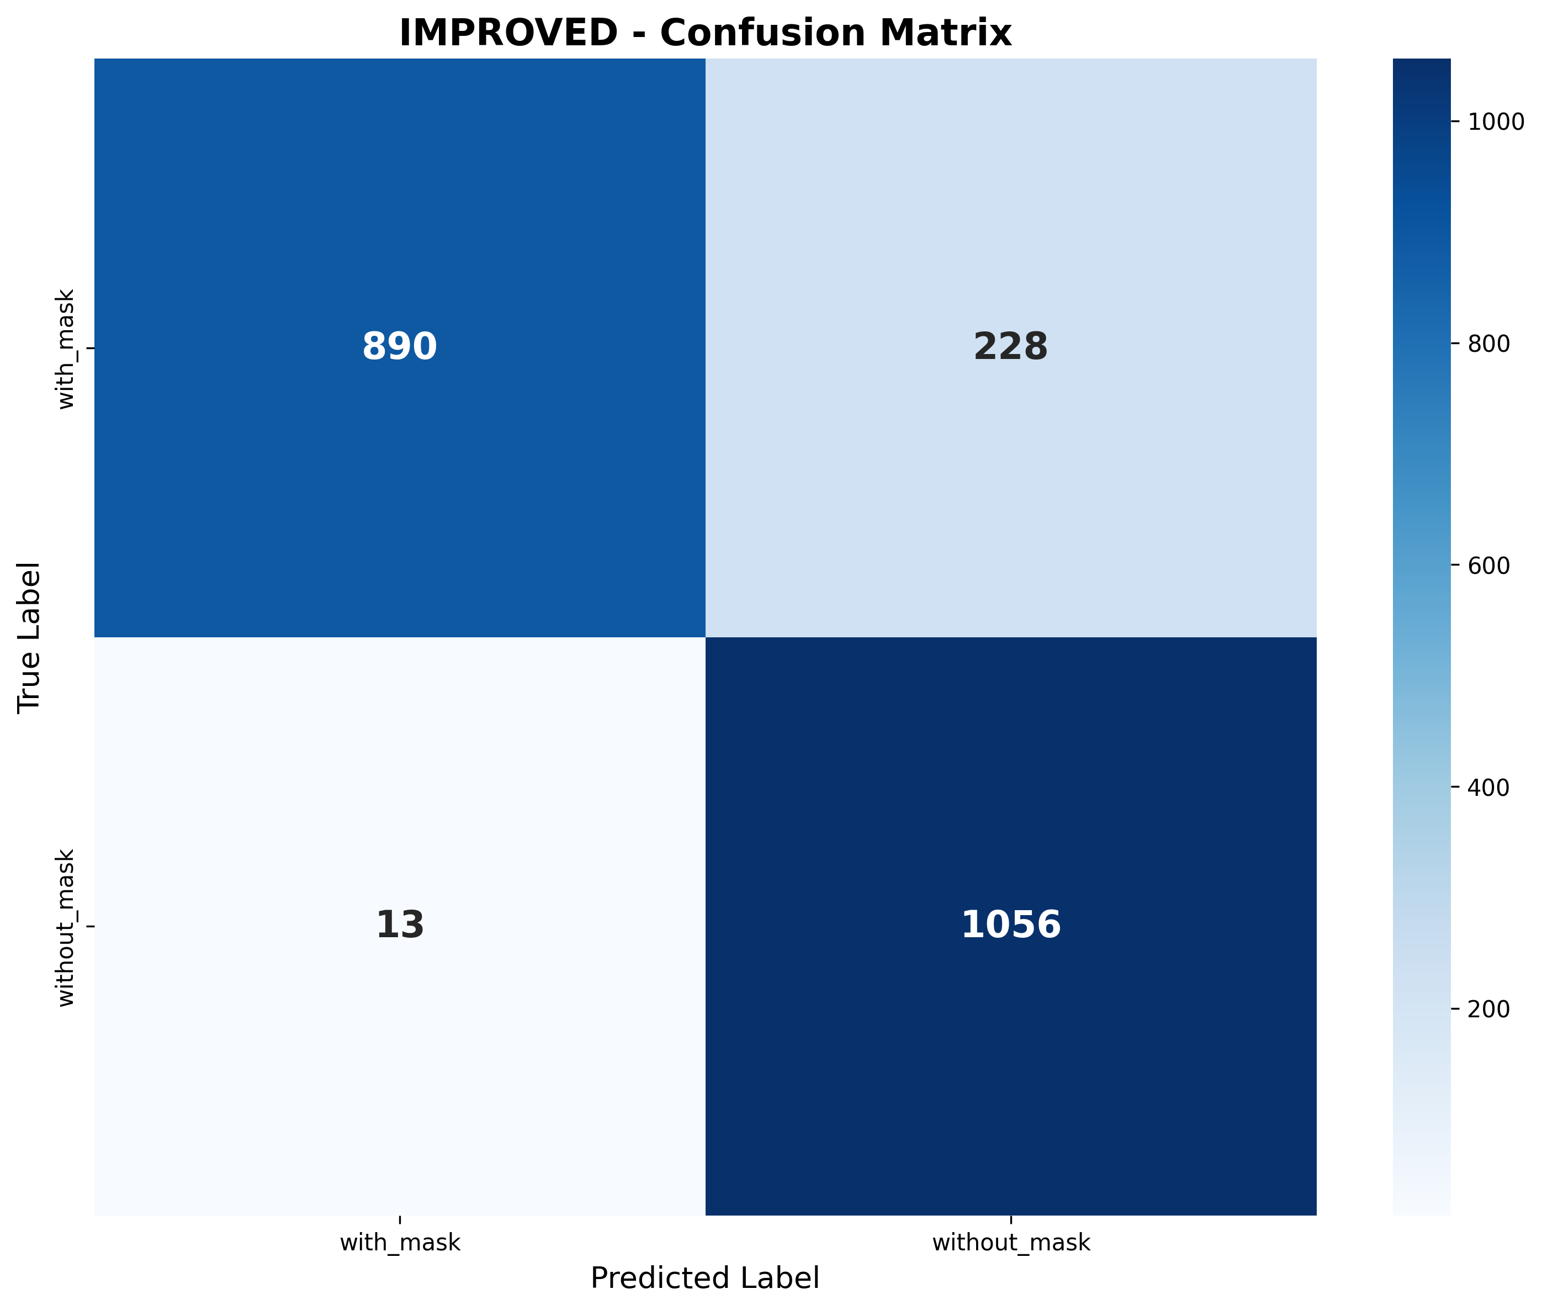
Results
Baseline Model
Improved Model
Class / Metric | Precision | Recall | F1-Score | Support
With Mask | 0.9856 | 0.7961 | 0.8808 | 1118
Without Mask | 0.8224 | 0.9878 | 0.8976 | 1069
Accuracy | — | — | 0.8898 | 2187
Macro Average | 0.9040 | 0.8920 | 0.8892 | 2187
Weighted Average | 0.9058 | 0.8898 | 0.8890 | 2187

Slide 12
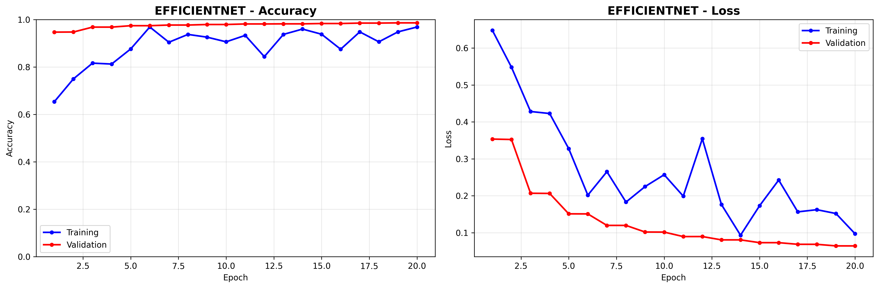
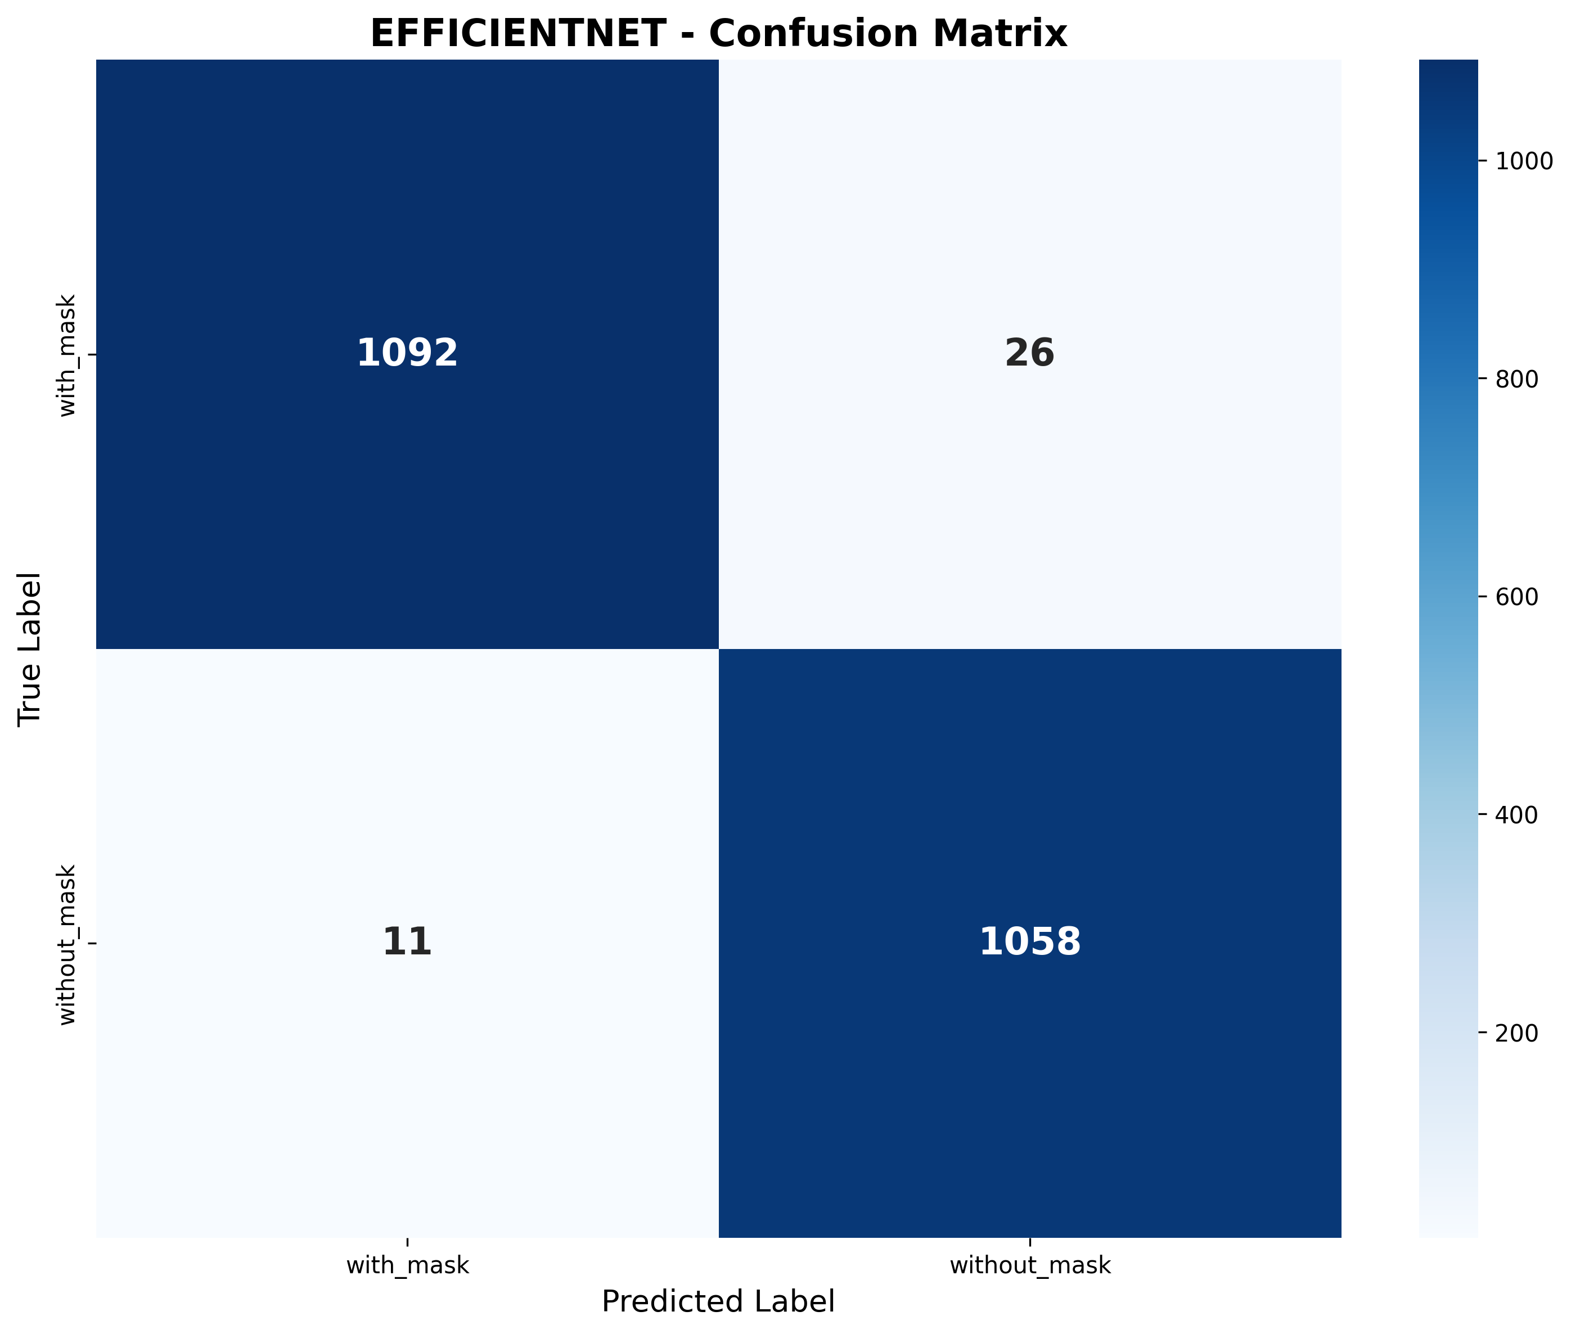
Results
Baseline Model
Improved Model
EfficientNetB0
Class / Metric | Precision | Recall | F1-Score | Support
With Mask | 0.9900 | 0.9767 | 0.9833 | 1118
Without Mask | 0.9760 | 0.9897 | 0.9828 | 1069
Accuracy | — | — | 0.9831 | 2187
Macro Average | 0.9830 | 0.9832 | 0.9831 | 2187
Weighted Average | 0.9832 | 0.9831 | 0.9831 | 2187

Slide 13
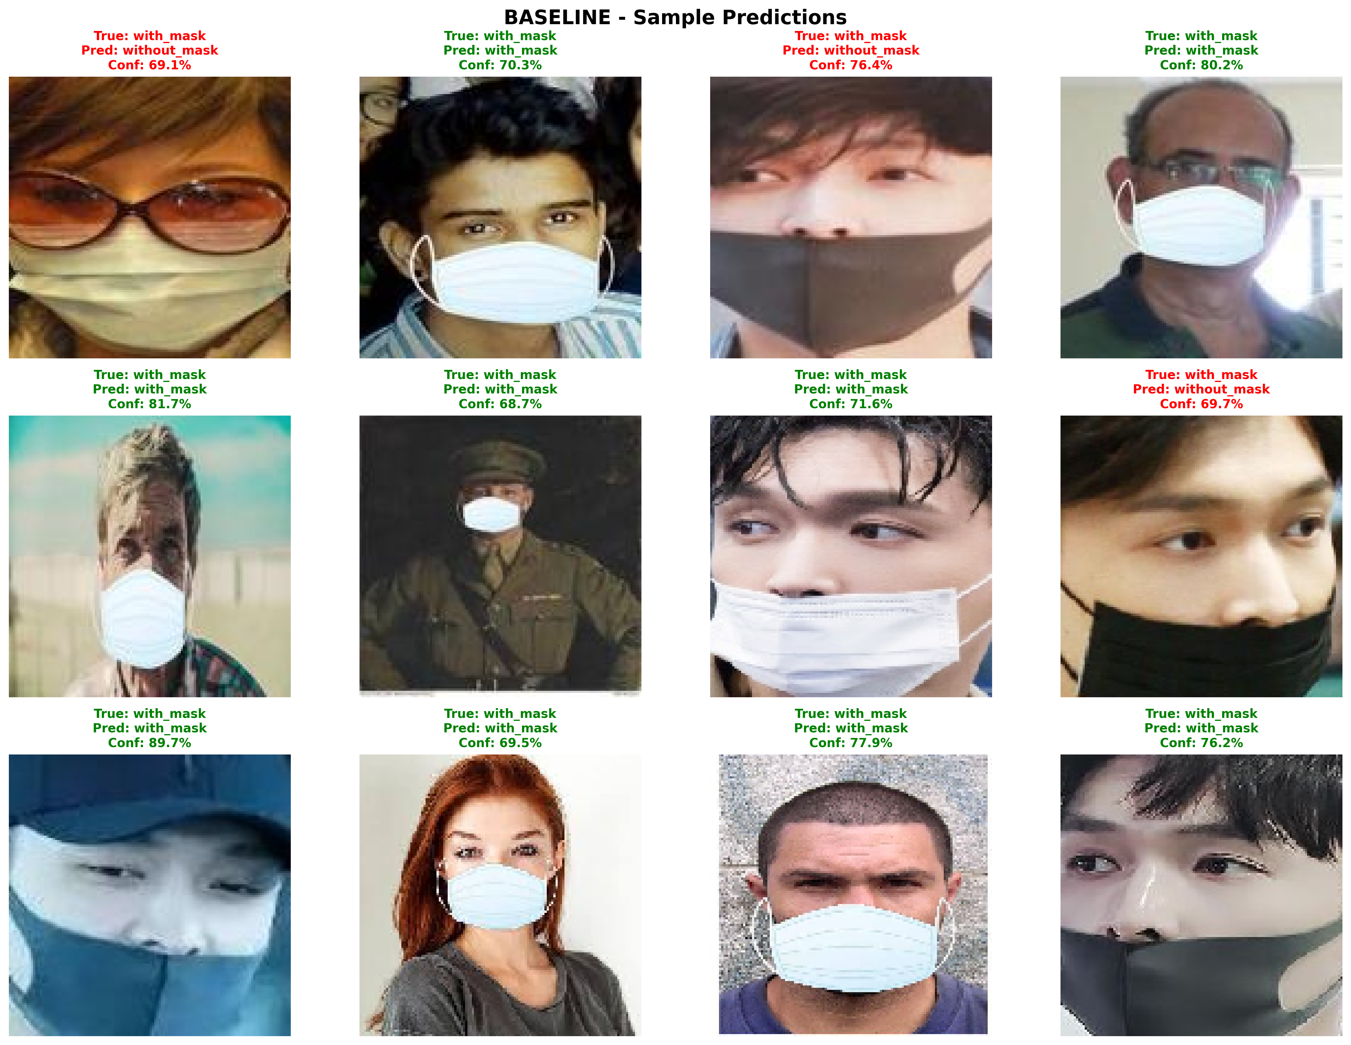
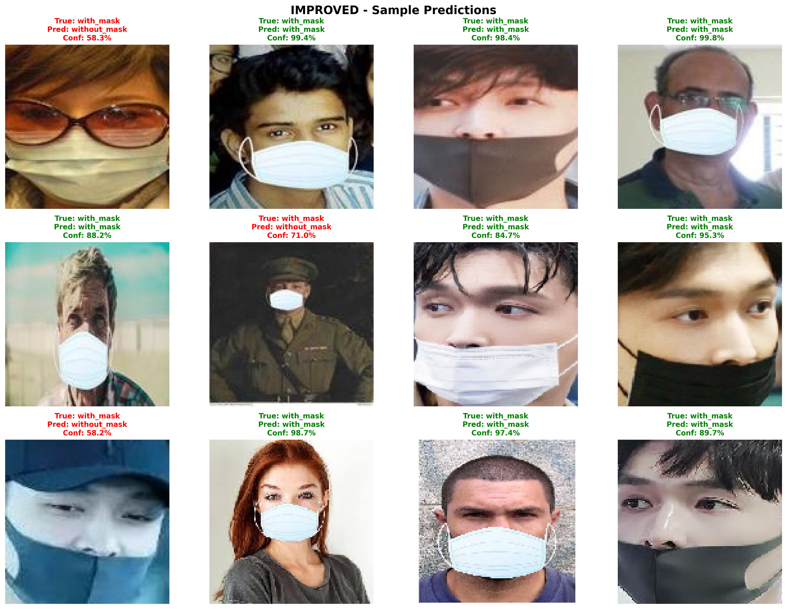
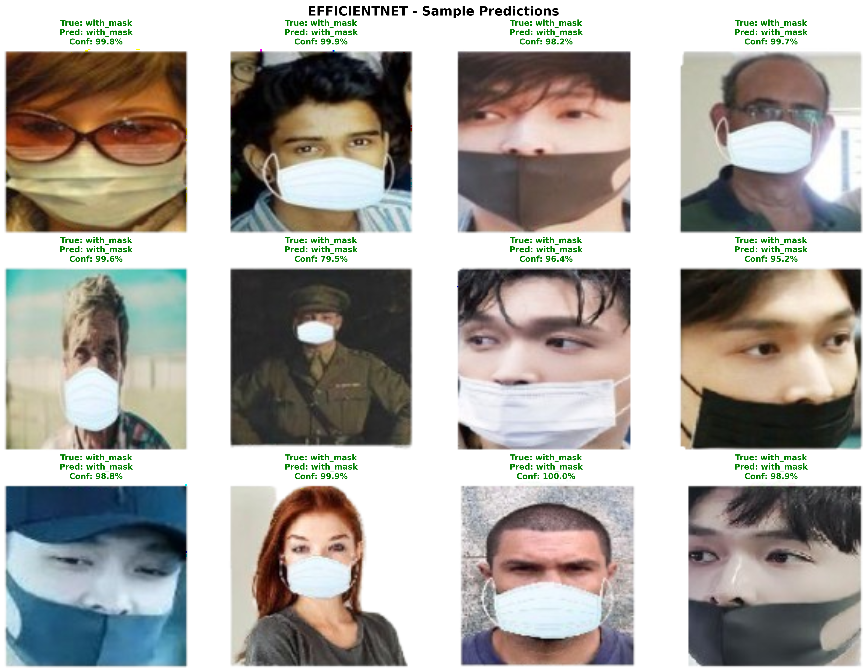
Sample Predictions
Baseline
Improved
EfficientNet

Slide 14
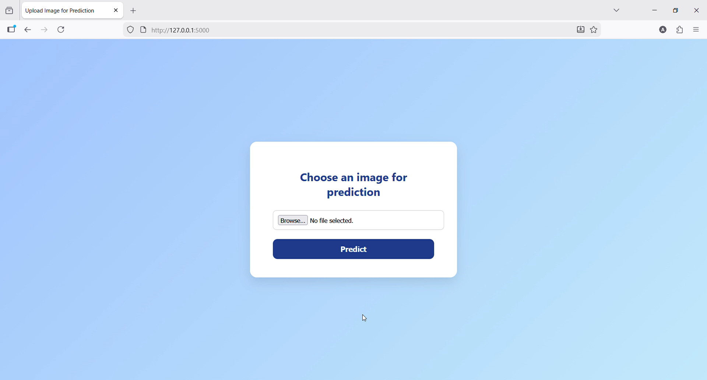
Deployment

